Slide 1


WELCOME
To Our Project Presentation
history
history
history
Teams
history
follow
services
teams
about
timeline
about
follow
about
services
teams
2DAnimation
timeline
about
about
about
about
about
about
GamePlay
CONTENTS
supervisor
Collision Detection
Requirements
Introduction
Score Counting
Moving Wall
Objective Selection
Flappy Bird
Team: The Brainy Fools

Slide 2

WELCOME
To Our Project Presentation
Teams
supervisor
history
history
history
history
2DAnimation
follow
services
teams
about
timeline
about
follow
about
services
teams
about
about
timeline
about
about
about
about
GamePlay
CONTENTS
Falguni Roy
Score Counting
Moving Wall
Requirements
Introduction
Collision Detection
Objective Selection
Flappy Bird
Lecturer
Institute Of Information Technology
Noakhali Science And Technology University

Slide 3



WELCOME
01
02
03
To Our Project Presentation
history
history
history
Teams
history
follow
services
teams
about
2DAnimation
timeline
about
follow
about
services
teams
about
about
timeline
about
Mentor
about
about
about
GamePlay
Introduction
Score Counting
Moving Wall
Requirements
CONTENTS
Collision Detection
Objective Selection
Flappy Bird
Md.Al-Adnan
Moonmoon Das
Akash Chandra Debnath
ASH1825008M
BKH1825027M
ASH1825037M

Slide 4



WELCOME
To Our Project Presentation
history
Teams
history
history
history
2DAnimation
follow
services
teams
about
timeline
about
follow
about
Mentor
services
teams
about
about
timeline
about
about
about
about
GamePlay
Collision Detection
Requirements
Introduction
CONTENTS
Score Counting
Moving Wall
Objective Selection
Flappy Bird
Introduction
GamePlay
Requirement

Slide 5
WELCOME
Flappy Bird is a Side-Scroller game where the player controls a bird,
Attemting to fly between columns of green pipes without hitting them
To Our Project Presentation
history
Teams
history
history
history
2DAnimation
Mentor
follow
services
teams
about
timeline
It’s a simple game of infinite level type
about
follow
about
services
teams
about
about
timeline
about
about
about
about
GamePlay
CONTENTS
Score Counting
Moving Wall
Requirements
Introduction
Collision Detection
Objective Selection
Flappy Bird
It’s a challenging game for anyone

Slide 6
WELCOME
We plan on creating a 2D version of Flappy Bird.
The bird will be moving forward continuously between sets of pipes
The bird jumps up a small amount whenever the mouse is pressed
If the bird collides with a pipe, the ground , or the ceiling ,than the game is over. The pipes will have a random size and be created in random locations
If any player navigates between each pair of pipes, the player earn a single point
To Our Project Presentation
history
Teams
history
history
history
follow
services
teams
about
timeline
about
follow
about
services
teams
about
timeline
about
GamePlay
Mentor
about
about
2DAnimation
CONTENTS
about
about
Introduction
Collision Detection
Requirements
Score Counting
Moving Wall
Objective Selection
Flappy Bird

Slide 7
WELCOME
2D Animation
Objective Selection
Moving Wall
Collision Detection
Moving BackGround
Score Counting
To Our Project Presentation
history
Teams
history
history
history
2DAnimation
Moving Wall
Requirements
follow
GamePlay
services
teams
about
timeline
CONTENTS
about
follow
about
services
teams
Score Counting
about
timeline
about
Introduction
Mentor
about
about
Objective Selection
about
about
Collision Detection
Flappy Bird

Slide 8



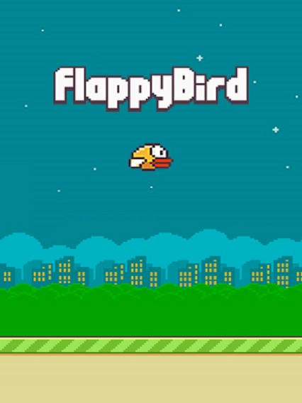



WELCOME
To Our Project Presentation
history
Teams
history
history
history
follow
Mentor
services
teams
about
timeline
GamePlay
about
follow
about
services
teams
about
about
timeline
about
about
about
about
CONTENTS
Moving Wall
Requirements
Introduction
Score Counting
Objective Selection
2DAnimation
Objective Selection
Flappy Bird

Slide 9
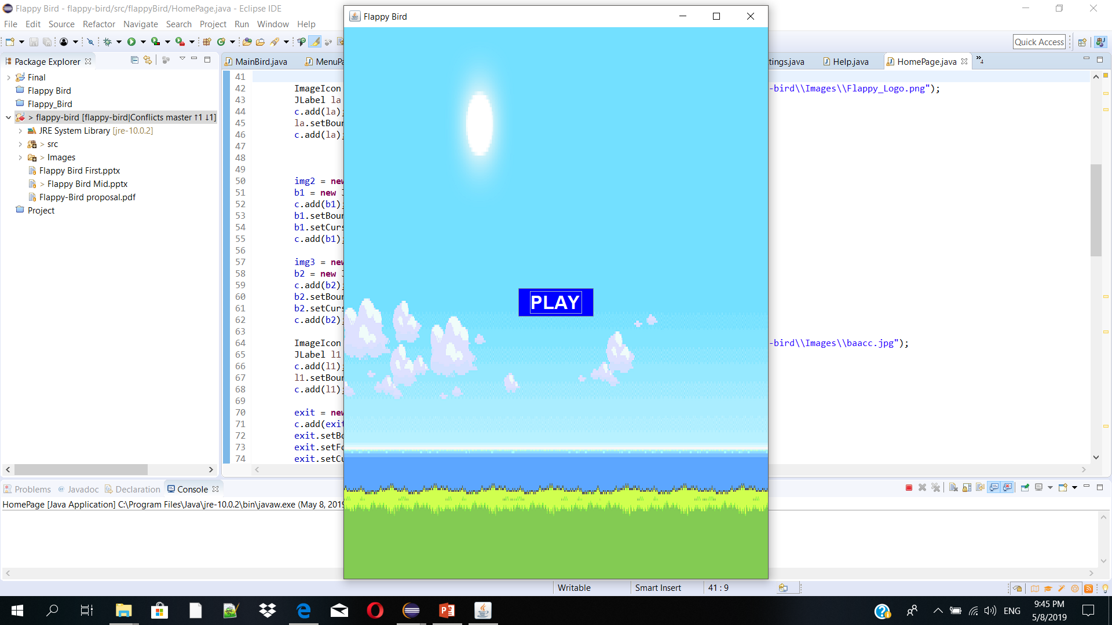
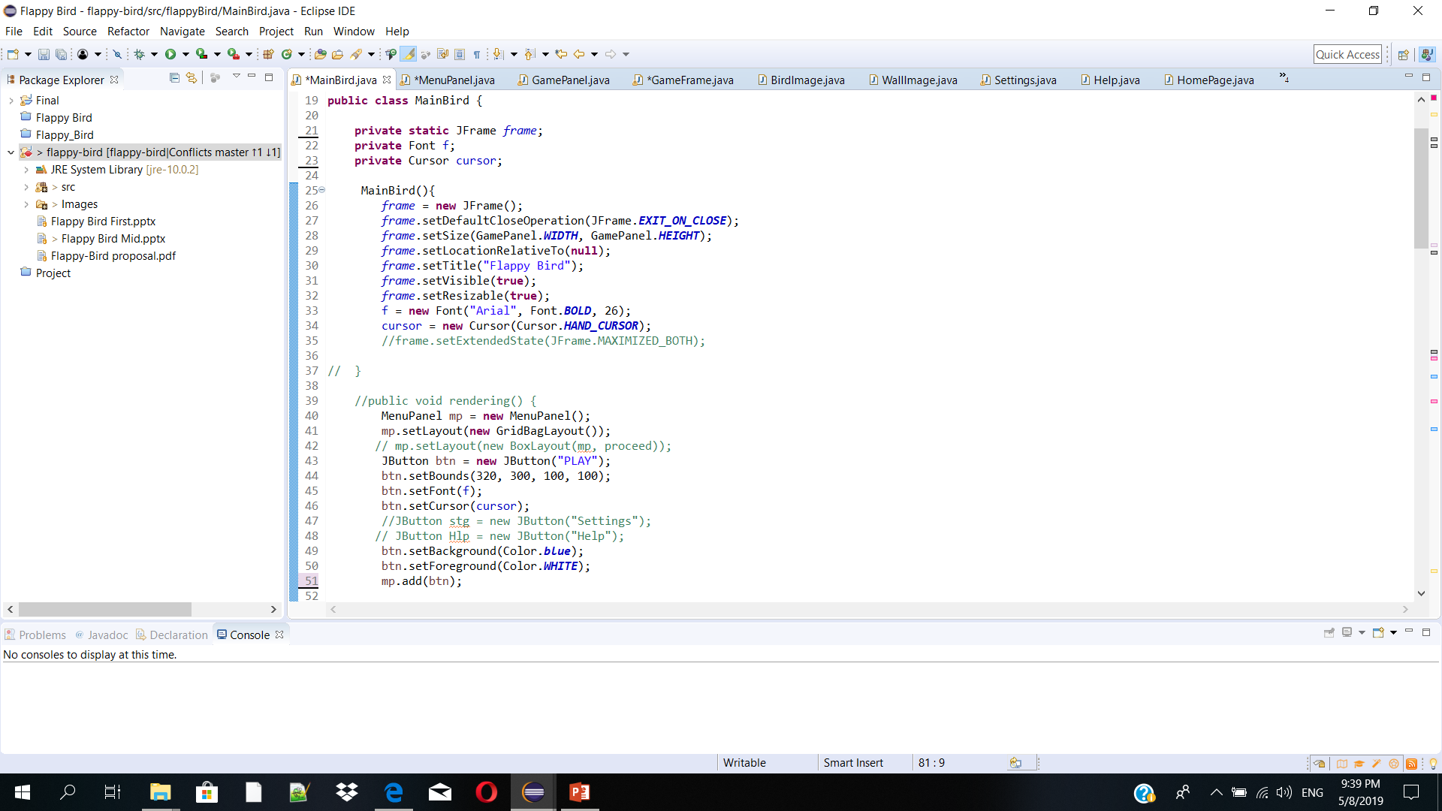
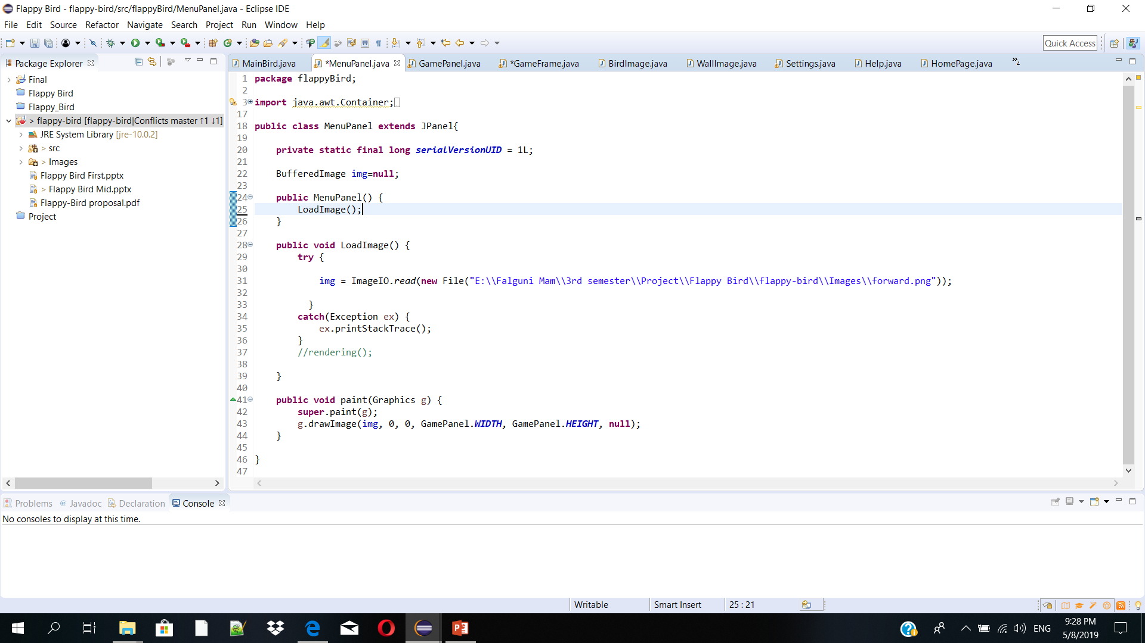
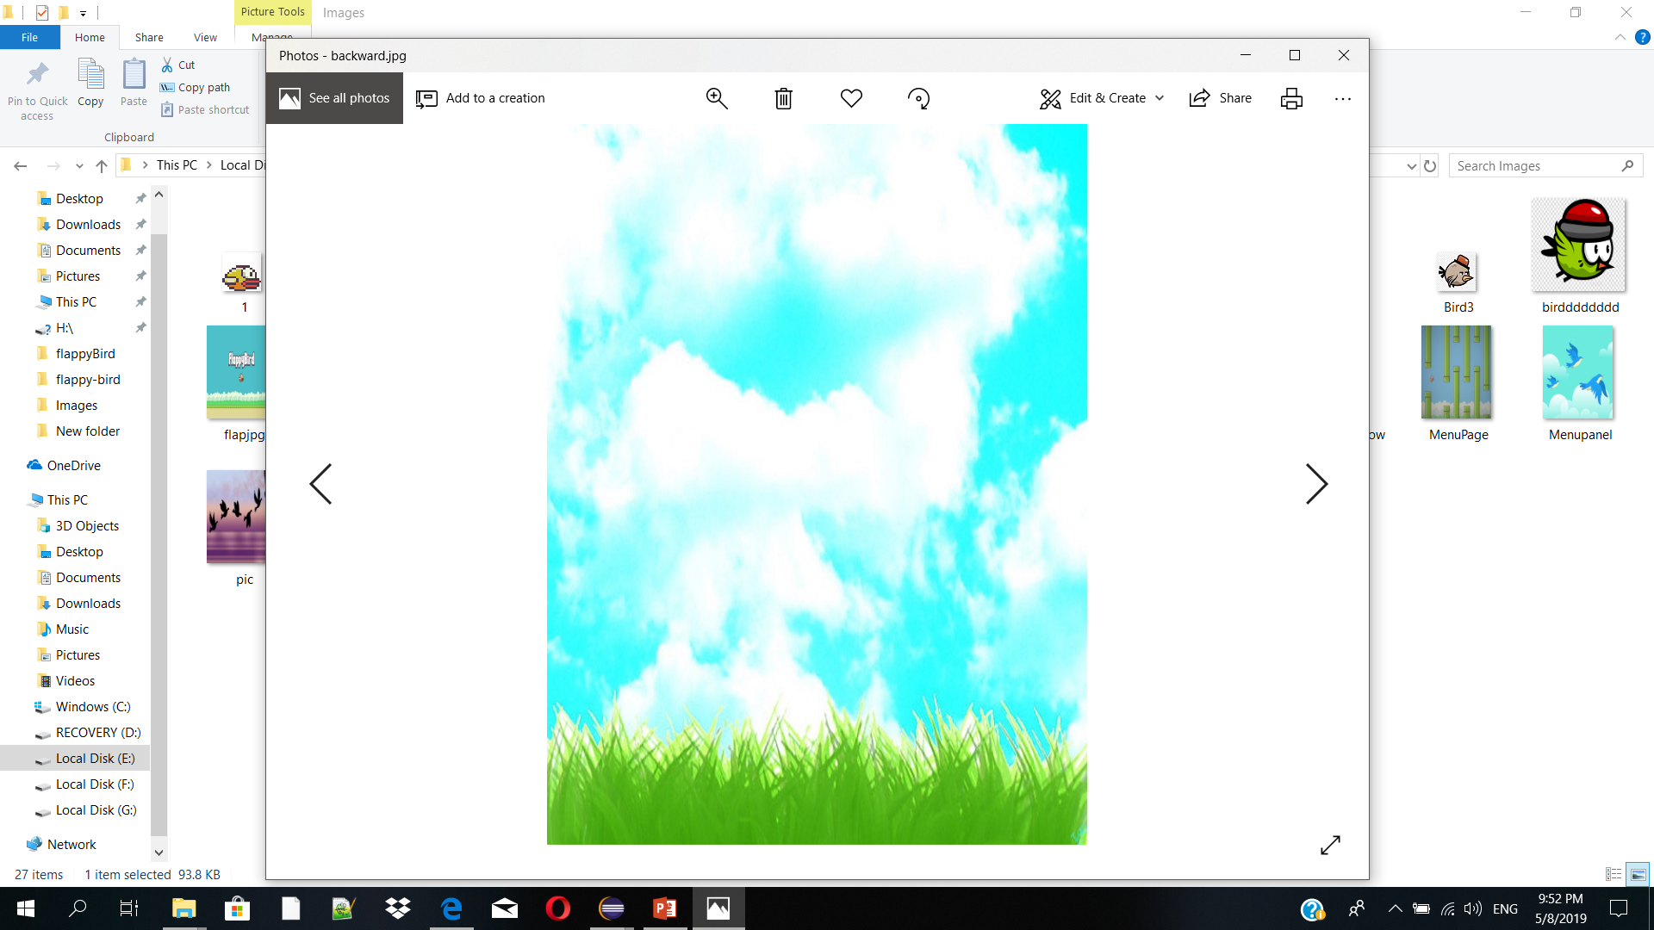
WELCOME
JPanel
To Our Project Presentation
history
Teams
history
history
history
history
follow
Mentor
services
teams
about
timeline
GamePlay
about
follow
about
services
teams
about
about
timeline
about
Gameplay Background
about
about
Objective
Selection
about
about
2DDemo
CONTENTS
Requirements
Introduction
2DAnimation
Flappy Bird
Paint
If we click PLAY button we directly go to the gameplay background

Slide 10
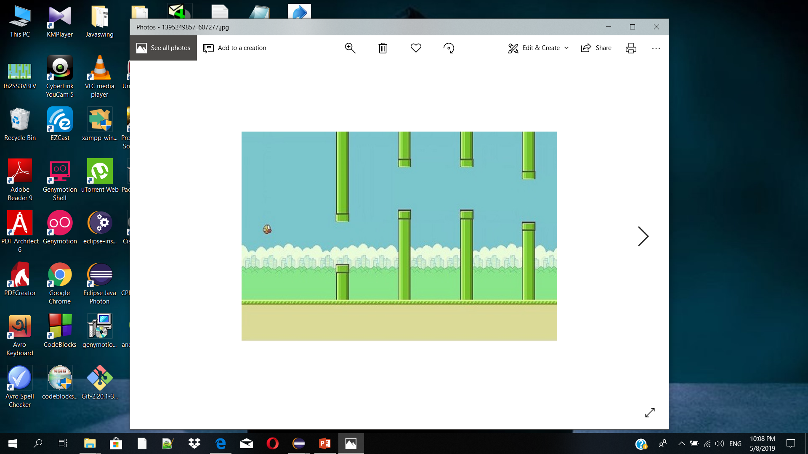
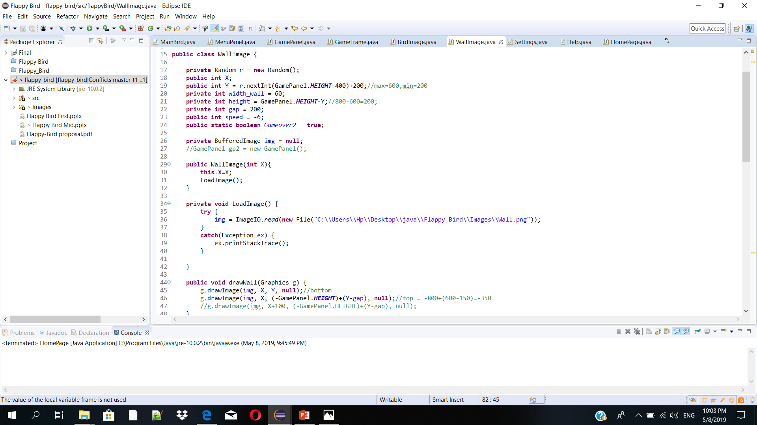
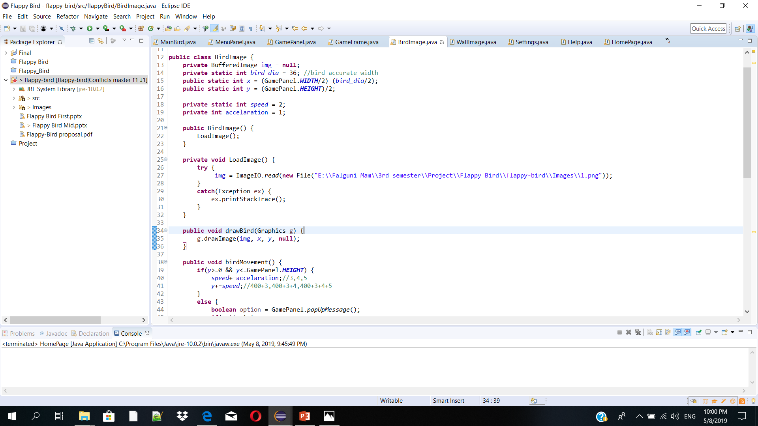

Background
600
600*3=18000
(0,0)
WELCOME
Birds width
(600/3)-(34/2)
=183
Window
To Our Project Presentation
history
Teams
history
history
Objective
Selection
history
history
follow
Mentor
services
teams
about
timeline
GamePlay
about
follow
about
services
teams
about
about
timeline
about
about
about
about
about
CONTENTS
Requirements
Introduction
2DAnimation
Flappy Bird
800/2=400

Slide 11
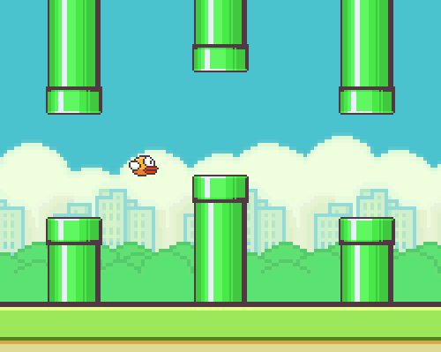
WELCOME
To Our Project Presentation
history
Teams
history
history
history
Objective
Selection
GamePlay
Mentor
follow
Moving Wall
services
teams
about
timeline
about
follow
about
services
teams
about
timeline
about
Introduction
about
CONTENTS
about
about
about
about
2DAnimation
Requirements
Flappy Bird

Slide 12
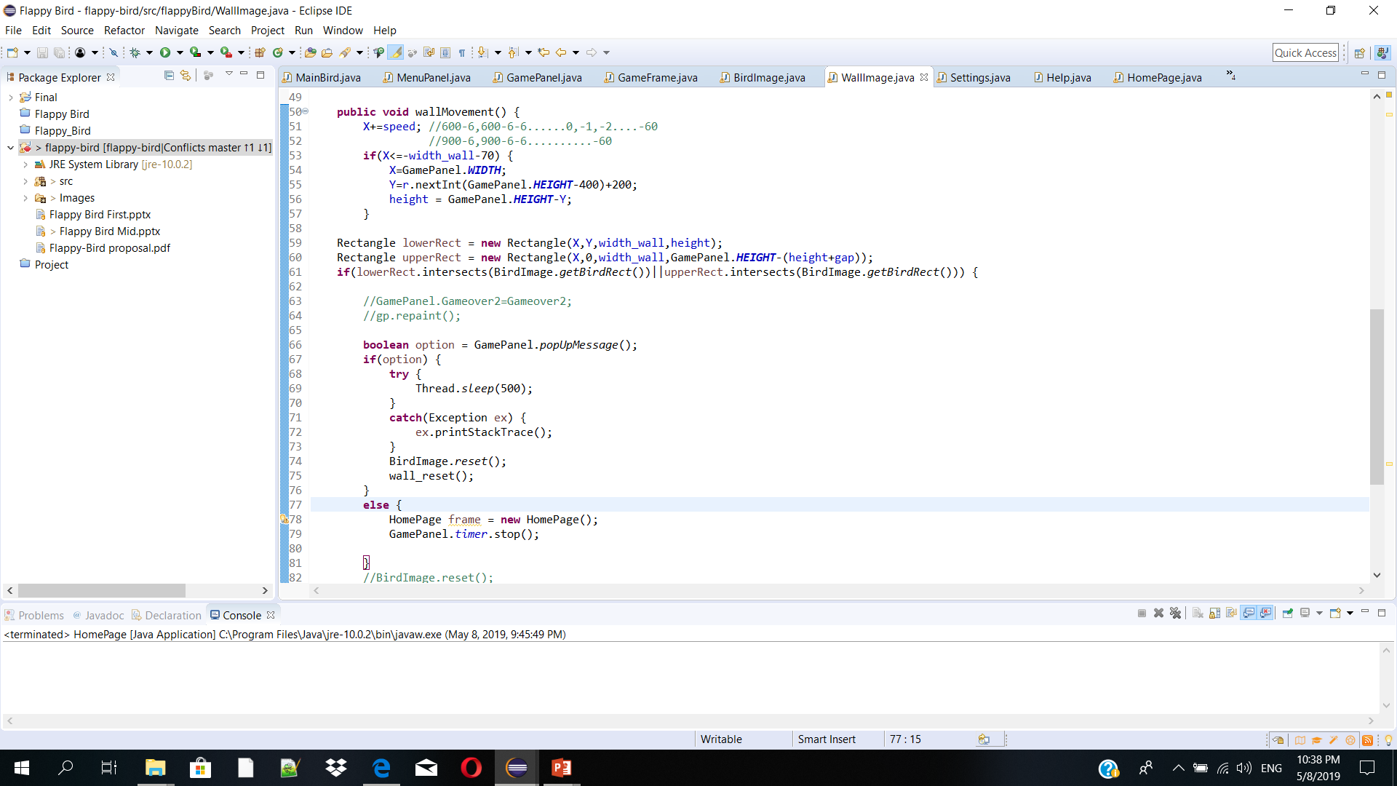
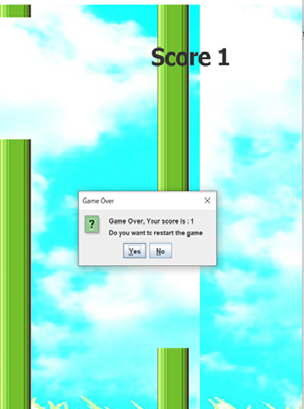
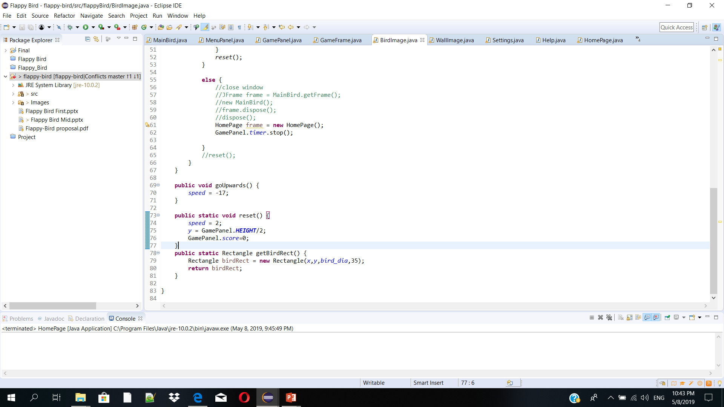
WELCOME
To Our Project Presentation
history
Teams
history
history
history
follow
Objective
Selection
Mentor
services
teams
about
timeline
about
follow
about
services
teams
about
about
timeline
about
GamePlay
about
about
about
CONTENTS
about
about
Collision
Detection
about
Moving Wall
2DAnimation
Introduction
Requirements
Flappy Bird

Slide 13
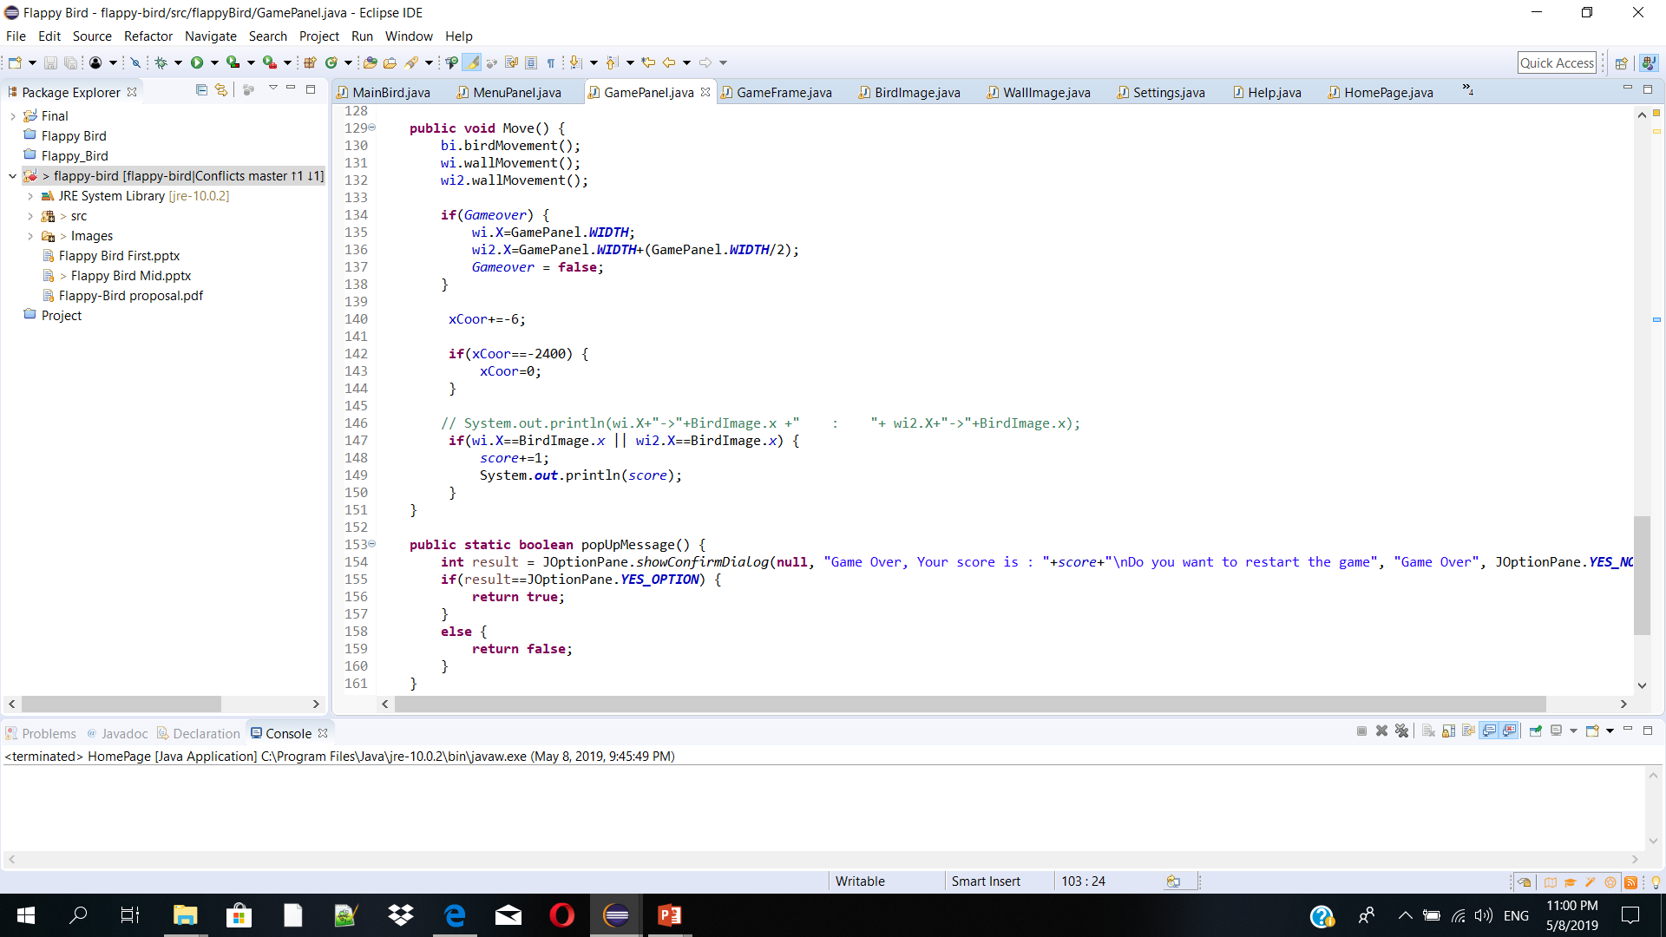

WELCOME
To Our Project Presentation
history
Teams
history
history
history
follow
Mentor
services
teams
about
timeline
Objective
Selection
about
follow
about
services
teams
about
about
timeline
about
Collision Detection
GamePlay
about
about
about
Moving Background
Moving Wall
CONTENTS
Introduction
Requirements
2DAnimation
Flappy Bird

Slide 14
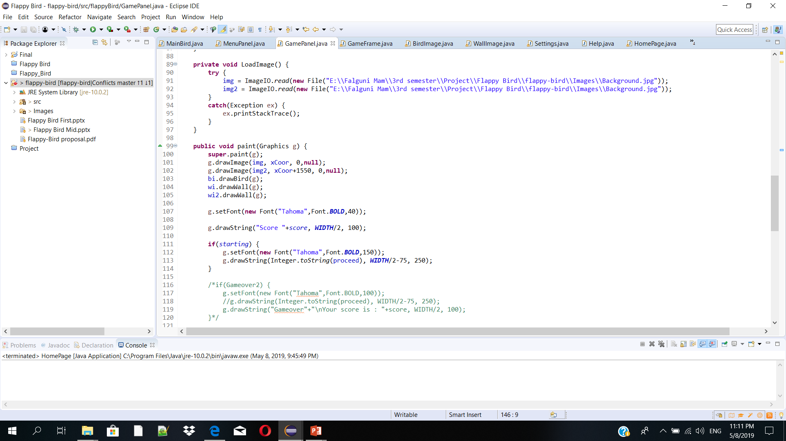
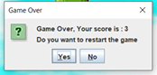
WELCOME
To Our Project Presentation
history
Objective
Selection
history
history
Moving Wall
history
follow
Collision Detection
services
teams
about
timeline
Requirements
about
follow
about
services
teams
about
about
timeline
about
about
Moving Background
about
about
TimeLine
Score Counting
Flappy Bird

Slide 15
T I M E L I N E
WELCOME
Requirement Analysis and Specification[Completed]
Coding[Completed]
To Our Project Presentation
Within 3rd
^{March}
Within 3rd weak of January
Within8 May
TimeLine
Flappy Bird
Within 17th January
Within 25th
April
Design And Study
Final Testing[Completed]
Proposal[Completed]

Slide 16
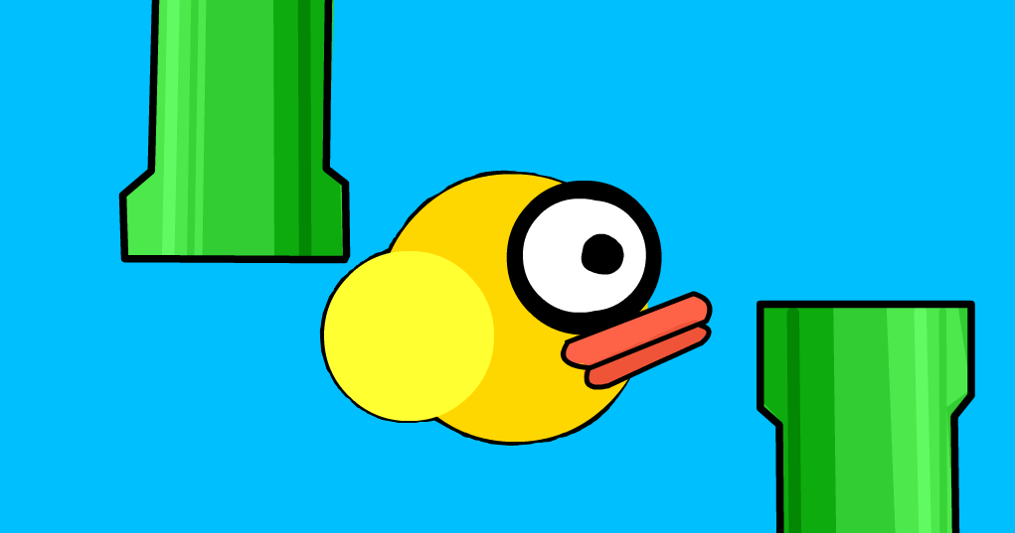
Now
Let’s Look At Our Game

Slide 17





